Slide 1
A Sea of Cyber Threats: Maritime Cybersecurity from the Perspective of Mariners
Anna Raymaker, Akshaya Kumar, Miuyin Yong Wong, Ryan Pickren, Animesh Chhotaray, Frank Li, Saman Zonouz, Raheem Beyah
Notes:
I’ll be presenting our work interviewing mariners to understand their experiences with cybersecurity and cyber-attacks

Slide 2
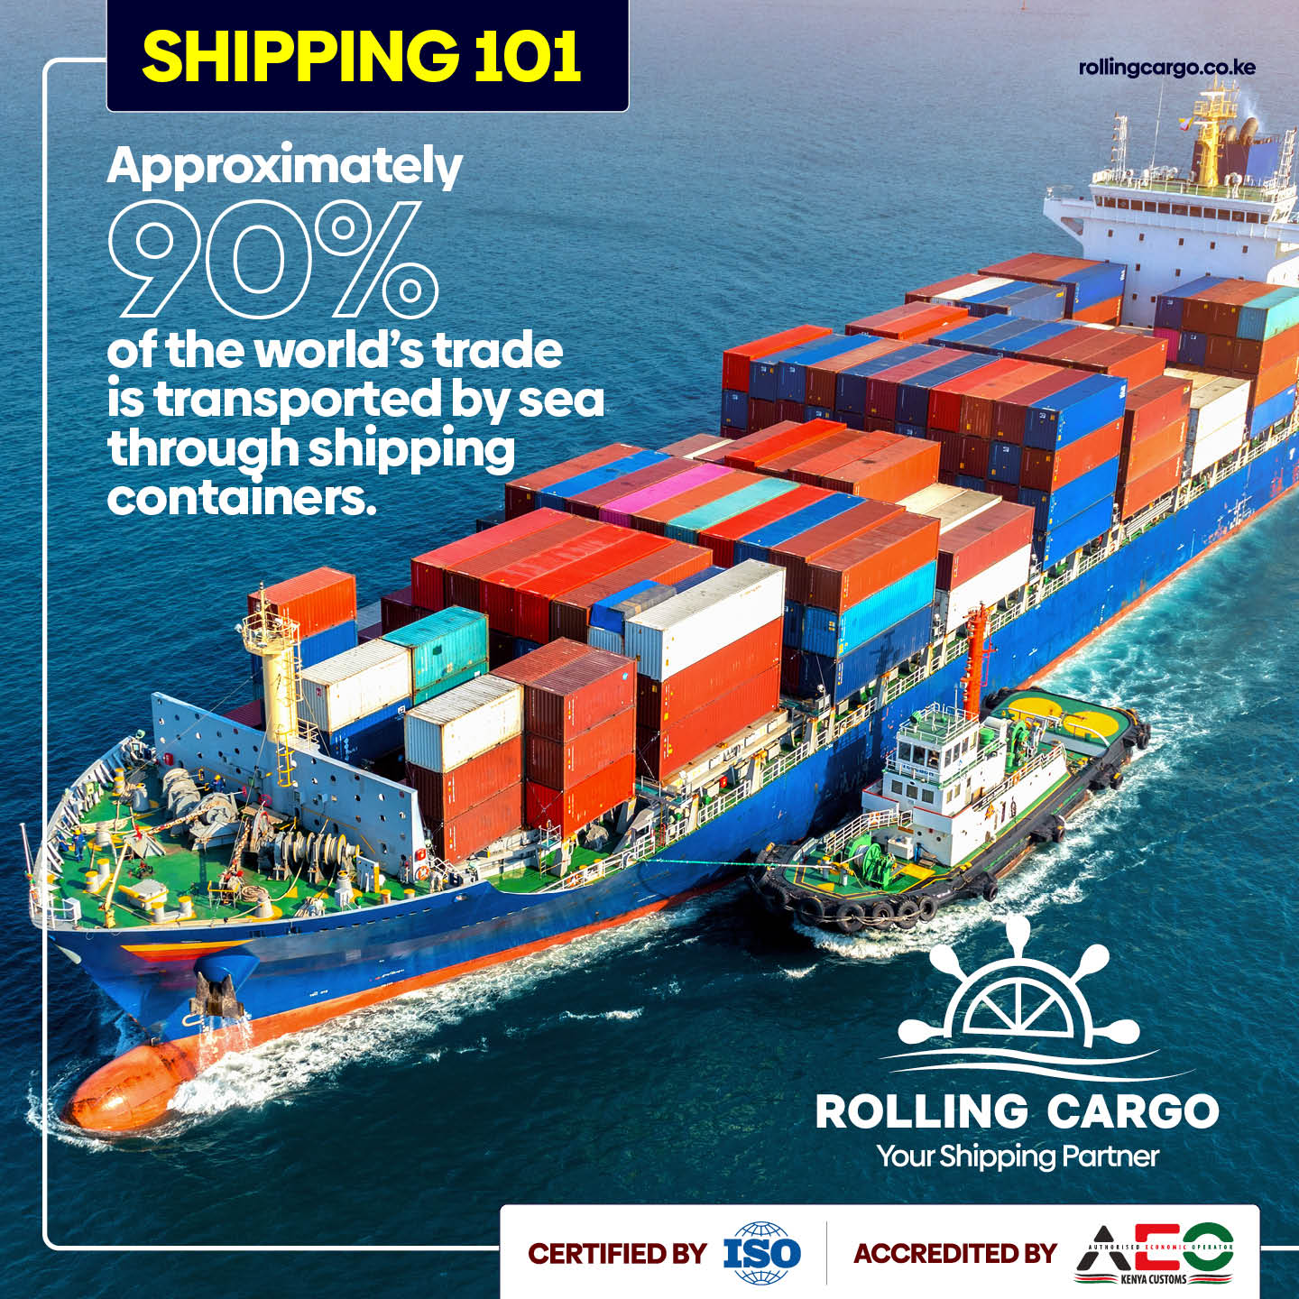
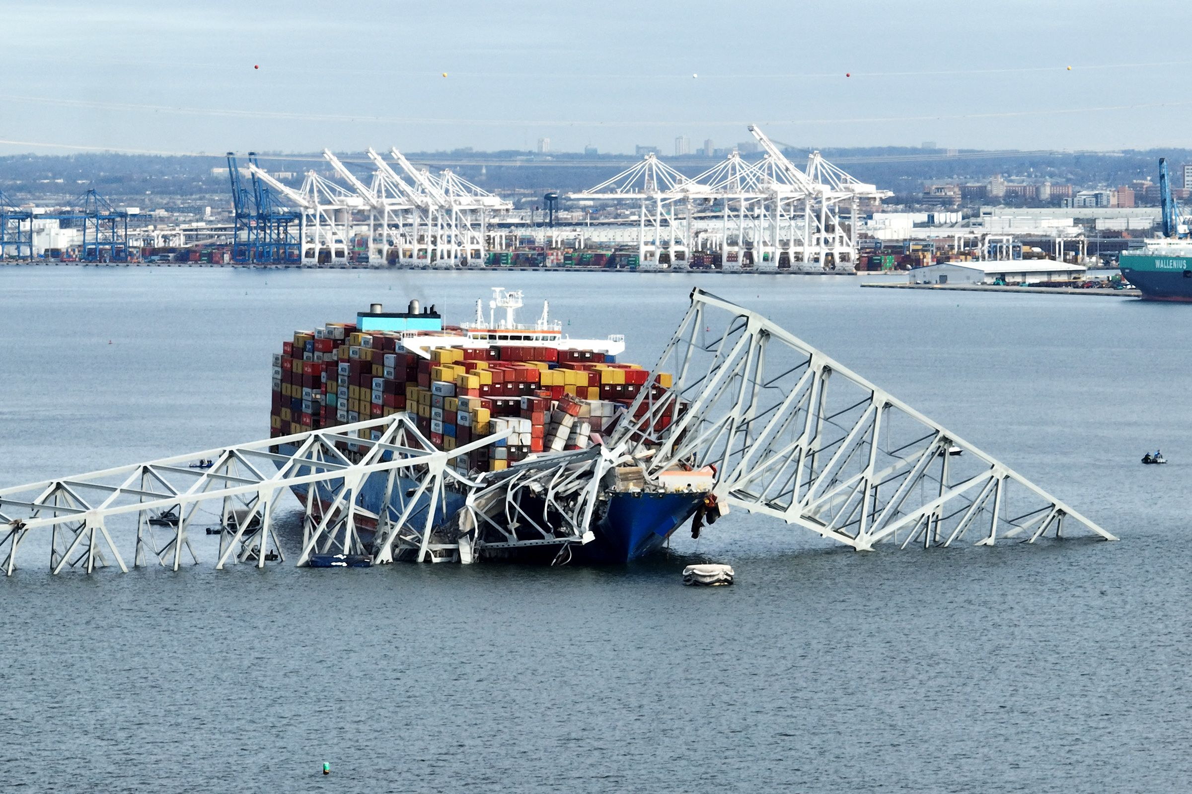
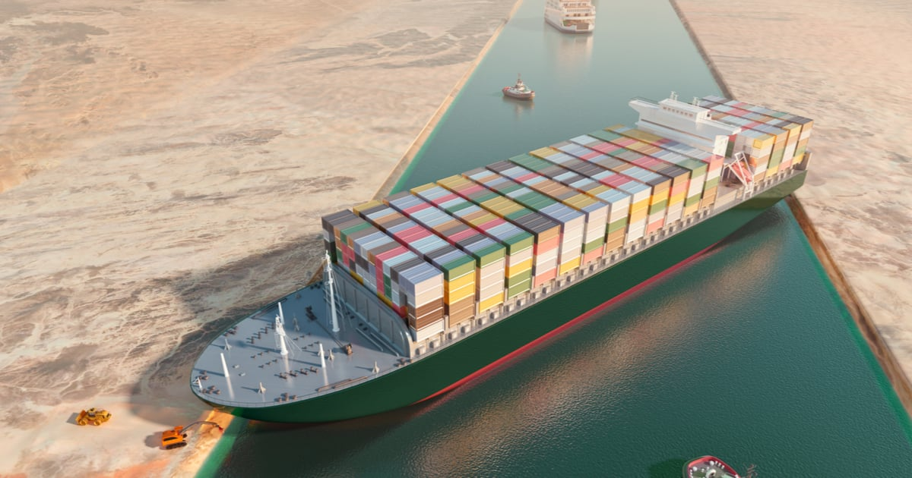
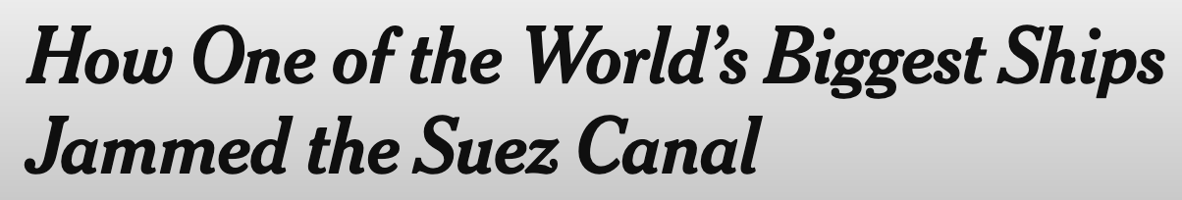
Motivation: Impact of Shipping on the Globe

Slide 3
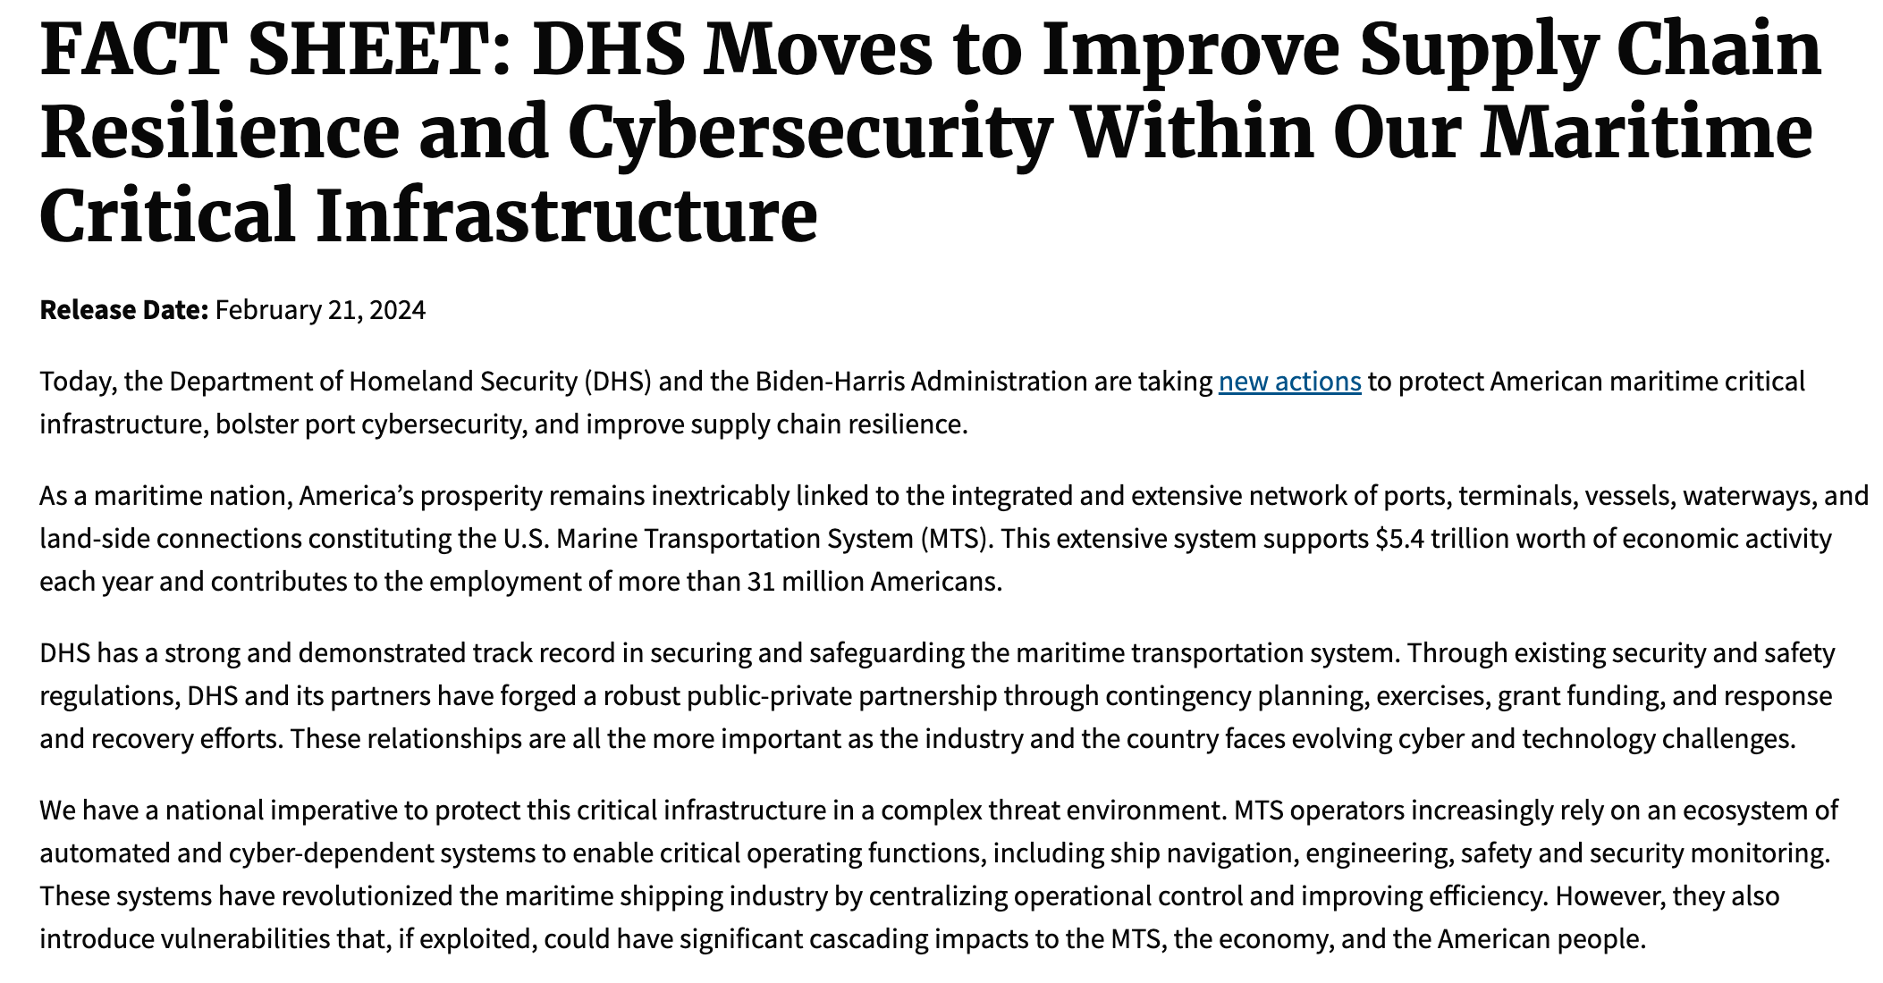
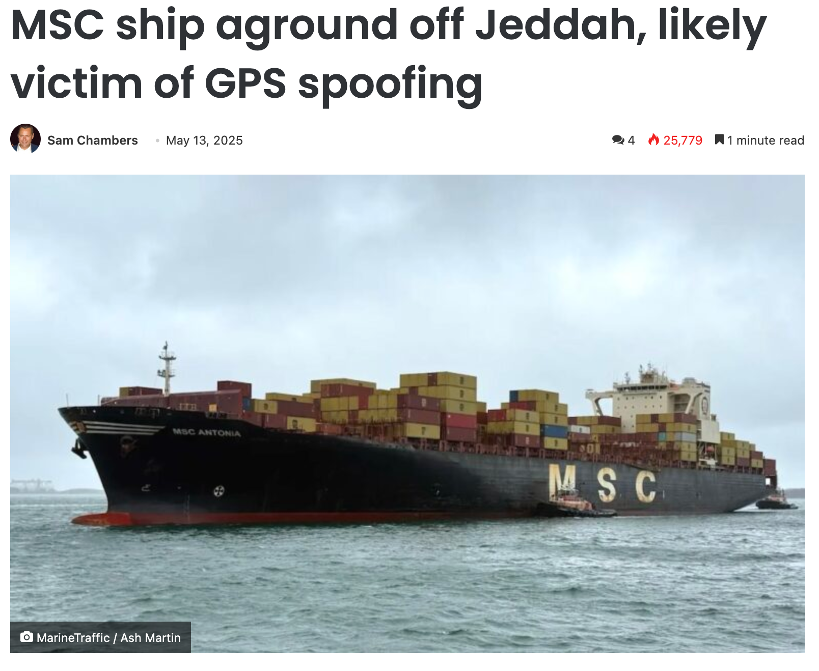
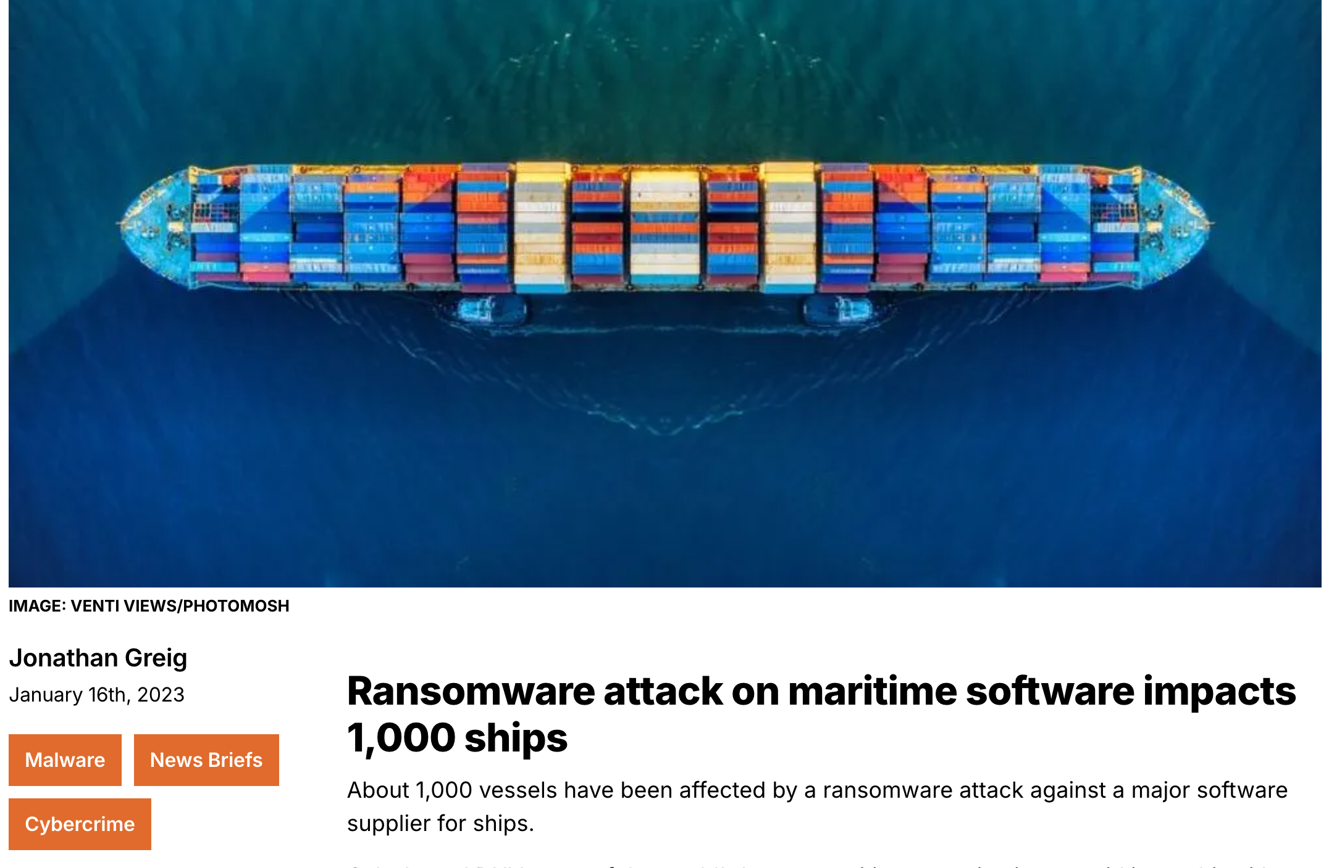
Motivation: Growing Cybersecurity Threats
Notes:
One of the first major ransomware attacks on ships. At least within the U.S., this has already become an issue. U.S. DHS. Look for international call for maritime security

Slide 4
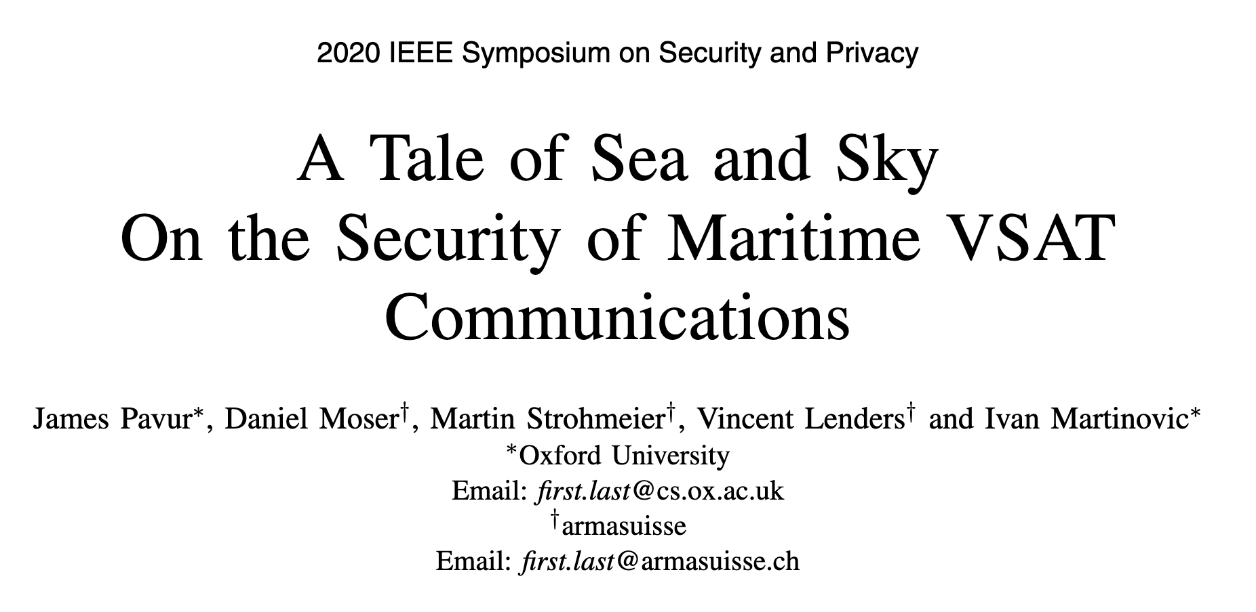
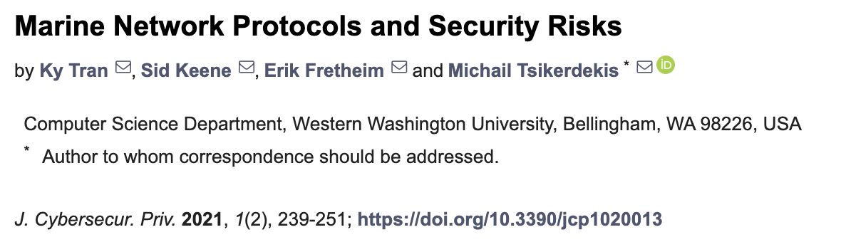
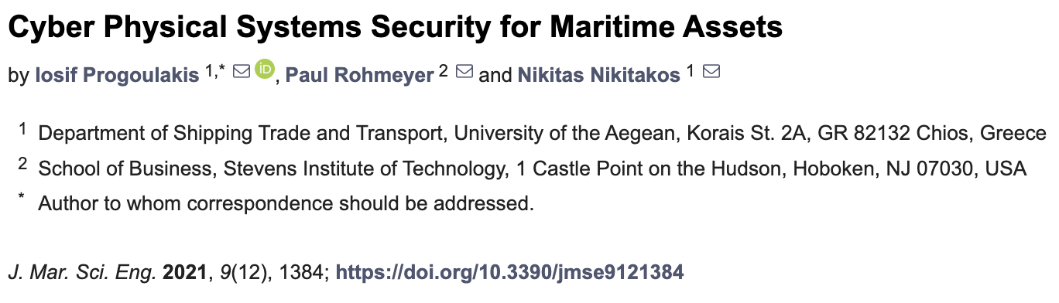
Limited Prior Work in Maritime Cybersecurity
Notes:
Not much and what has been done has only looked at narrow network protocols, has not been a broader look at the ecosystem (more positive)

Slide 5
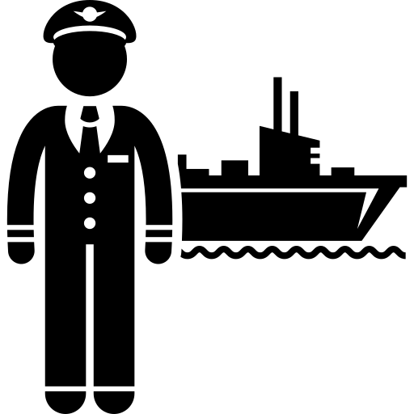

Closing the Research Gap
Focus on the human perspective
Goal: Expose what problems mariners face in practice
Notes:
If we are starting here, we need to get an idea for the problem space => human centered
Goal: Illuminate the problem space and see what problems mariners face in the wild

Slide 6





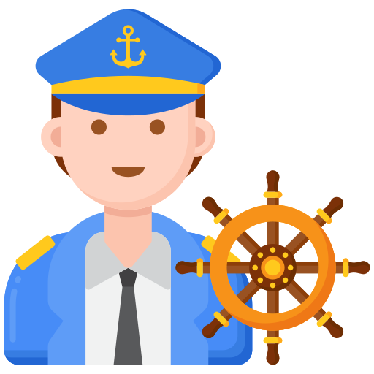
Questions to Investigate
RQ1: What are mariners’ perceptions of cybersecurity?
RQ2: What are mariners’ cybersecurity practices, and what role do training and regulation play in shaping these practices?

Slide 7

Perceptions
Recommendations
RQ1
Threats
RQ1
Training
RQ2
Regulation
RQ2
7

Slide 8
Method
Semi-structured interviews
Recruitment: gCaptain, Reddit, LinkedIn, and snowballing
Analysis: qualitative coding with two coders, iterative refinement, saturation reached
Notes:
Talk about recruiting or the method more. 1 bullet for recruiting. Something about the analysis method. Qualitative coding (2 coders). Duplicate this slide and add participant demographics. Separate Method and Demographics.

Slide 9




Participant Demographics
Interviewed 21 officer-level mariners
Civilian + Military backgrounds
Broad ages (20s to 70s!)
Diverse ship types (cargo, passenger, cable, etc.)
Notes:
Interviewed 21 offer-level mariners semi-structured
Captains, 1st mates, Engineers
Some military some not
All age ranges
Many different ship experiences (Cargo, buoy tender, under sea cable laying) => still hit saturation bc common themes

Slide 10
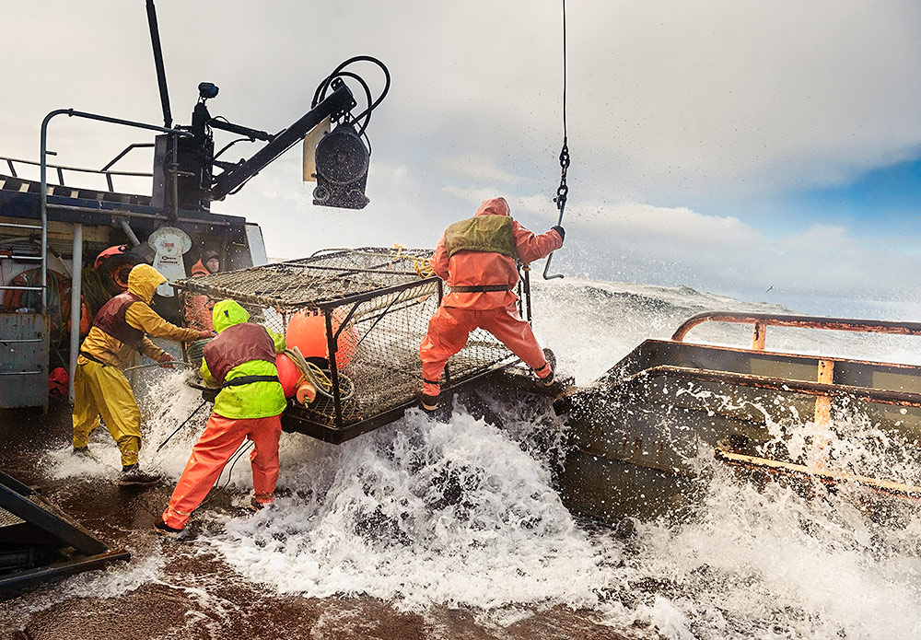
What did we find?
First, we found that mariners are up against steep challenges and difficult working conditions….

Slide 11






No Time Left for Cybersecurity
Smaller crews, heavier burden
Months away at sea
Exhausting hours, little rest
Constant physical and safety risks
“If you’re working 12 hours a day for 90 days… after 40 days you’re not as alert and you just don’t care.” (P6)
Notes:
Structure up front. One of the challenges we learned. Very unique + security consequences.
"No Time Left for Cybersecurity"
There are a lot of things that compete with cybersecurity for a mariner's attention....

Slide 12
Cybersecurity is seen as secondary to physical security
Perceptions
Recommendations
RQ1
Threats
RQ1
Training
RQ2
Regulation
RQ2
12

Slide 13
Mariner-Identified Threat Categorization
Our framework bridges mariner experiences with industry standards
Notes:
Mariners organize threats by when they feel vulnerable on ship.

Slide 14





Unprompted, Emerging Threats
Generational gap: old vs. new practices
“If you don’t have charts and you’re being spoofed, you’re a little screwed” (P18)
Starlink: faster, but unmanaged connectivity
Automation: fewer crew, heavier burden, more threats
Notes:
One thing we found is that younger mariners felt less prepared to navigate without GPS, though they also were better at operating electronic equipment. But if GPS goes out, they feel unable to navigate using traditional methods like celestial navigation.
Also heard this stuff (didn't ask directly about them). Emerging concerns that were surprisingly discussed with out prompting.
“If you don’t have charts and you’re being spoofed, you’re a little screwed” (P18)

Slide 15
Cybersecurity is seen as secondary to physical security
Perceptions
Recommendations
RQ1
From GPS to Starlink, mariners see growing, unmanaged cyber risks
Threats
RQ1
Training
RQ2
Regulation
RQ2
15

Slide 16




Training Fails to Prepare Mariners for Threats
All 21 mariners had generic, non-ship-specific training
14 reported no cyber response plan at all
“[The training] didn’t even really say how to identify a cyber-attack; it talks a lot about flash drives.” (P9)
8 admitted to unsafe practices
Notes:
Cybersecurity training questions gave some overarching insights. Pasting passwords to the bottom of keyboards and plugging USBs into ship system.

Slide 17
Cybersecurity is seen as secondary to physical security
Perceptions
Recommendations
RQ1
From GPS to Starlink, mariners see growing, unmanaged cyber risks
Threats
RQ1
Training
Training is generic, not role-specific, and often ignored
RQ2
Regulation
RQ2
17

Slide 18
Regulations Matter, But Don’t Fit the Crew
15/21 Mariners found regulations to be essential
“Most of the standards, regulations that we have in the maritime industry... are written in blood and oil. Mariners pay for it with their blood, sweat, and tears” (P7)
11/21 see regulations as burdensome
7/21 one-size-fits-all, not adequate for small crews
Only 10/21 aware of IMO cyber regulations
“A lot of retired Navy guys. . . they’re writing the regulation. But they’re writing it based off the Navy way of doing stuff with a 5,000 person crew on [an] aircraft carrier versus a 20 or 12 person crew” (P6)
Notes:
From questions on regulations we got other overarching insights. Only 10 mariners were even aware of the existence of cyber regulations.

Slide 19
Cybersecurity is seen as secondary to physical security
Perceptions
Recommendations
RQ1
From GPS to Starlink, mariners see growing, unmanaged cyber risks
Threats
RQ1
Training
Training is generic, not role-specific, and often ignored
RQ2
Standards are reactive, burdensome, and not tailored to ships
Regulation
RQ2
19

Slide 20

A lot to improve… but there’s hope!
There’s also clear ways we can help mariners….
Notes:
Clearly there is a lot to improve, but there are also clear ways we can help mariners as a community

Slide 21

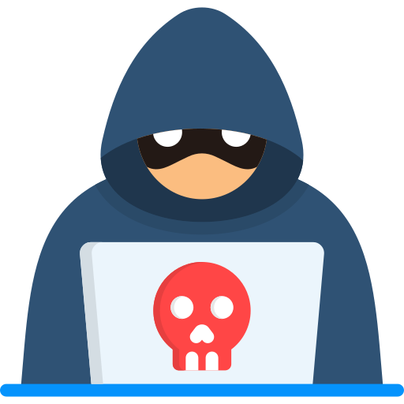
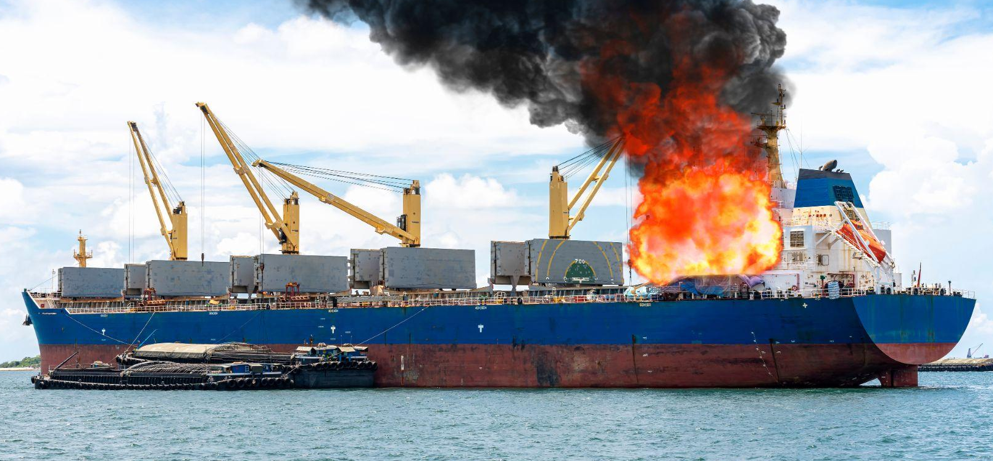

Recommendations
1. Connect cyber threats to real-world safety impacts
2. Deliver practical, role-specific training
3. Align regulations with operational realities
See paper for more details!
Notes:
Increase the connection between physical and cyber threats. If mariners better understand the physical consequences that cyber-attacks can have, they may treat it with the same seriousness as physical threats.
Mariners are not office workers and so office-aligned training is conterproductive.
For example, mariners mentioned new IAX standards describe how to secure newly built ships but not old ones. The standards should take existing ships and realistic conditions into account too.

Slide 22


A Brighter Future at Sea
Safer ships, empowered mariners, resilient seas
22
Notes:
If we align training, practice, and regulation,
we can make the future of maritime cybersecurity brighter.
We can continue to research this area and help mariners by using their experiences in systematic research

Slide 23
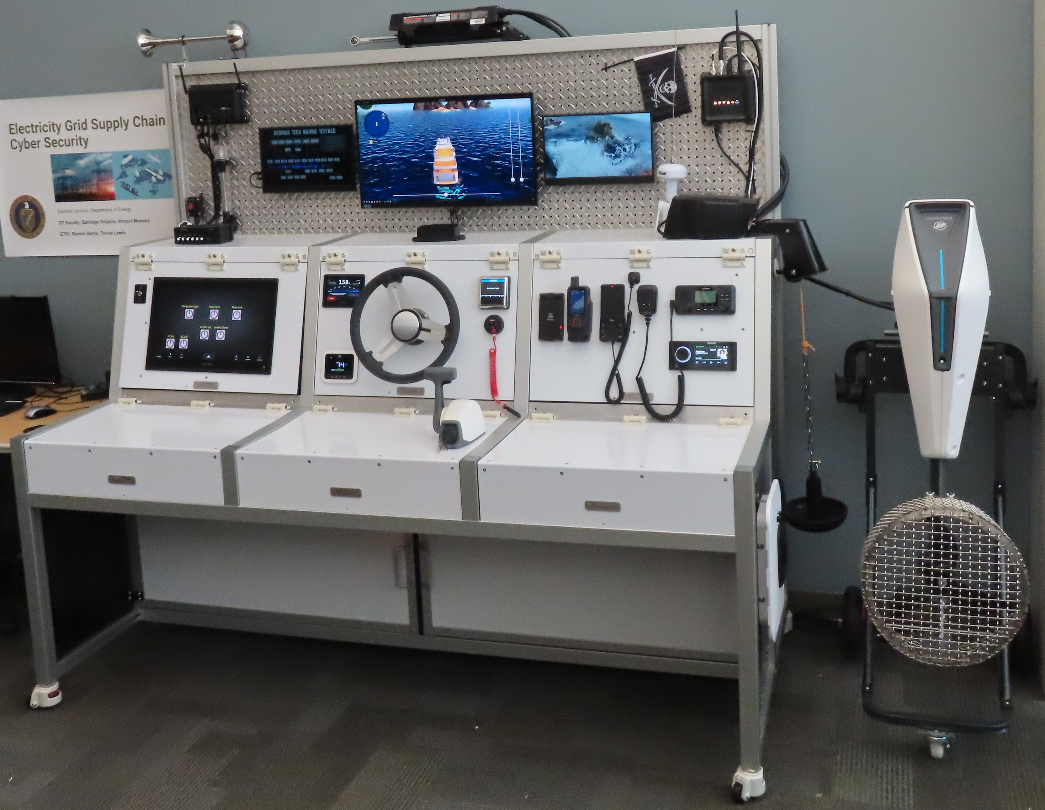
Turning stories into systems….
Our Maritime Testbed
Notes:
We are already using mariner insights to do follow-up work at Georgia Tech, including building a testbed that is representative of a real marine vessel. Feel free to chat with me after the talk about this more.

Slide 24
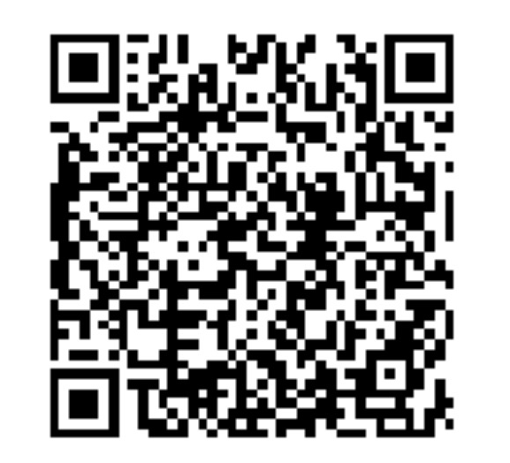
Cybersecurity is seen as secondary to physical security
Perceptions
Recommendations
RQ1
1. Connect cyber to physical consequences
From GPS to Starlink, mariners see growing, unmanaged cyber risks
Threats
RQ1
2. Deliver practical, role-specific training
Training
Training is generic, not role-specific, and often ignored
3. Align regulations with real-world conditions
RQ2
Standards are reactive, burdensome, and not tailored to mariners
Regulation
RQ2
Contact me!!
Email: araymaker3@gatech.edu
24
Notes:
Thank you for listening. Any questions?

